Slide 1
Assignment 9 & 10: Charts
DSC640-T301 Data Presentation and Visualization
Date:2/6/2023
By: Joshua Greenert

Slide 2
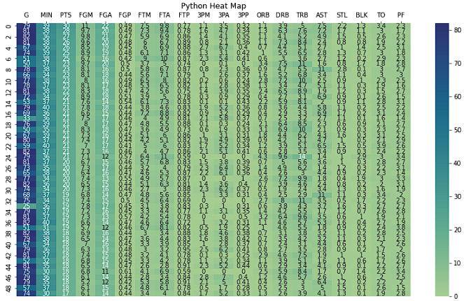
Python Charts

Slide 3
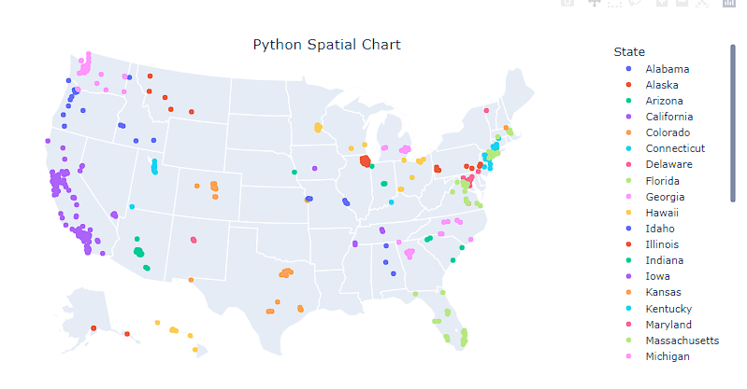
Python Charts

Slide 4
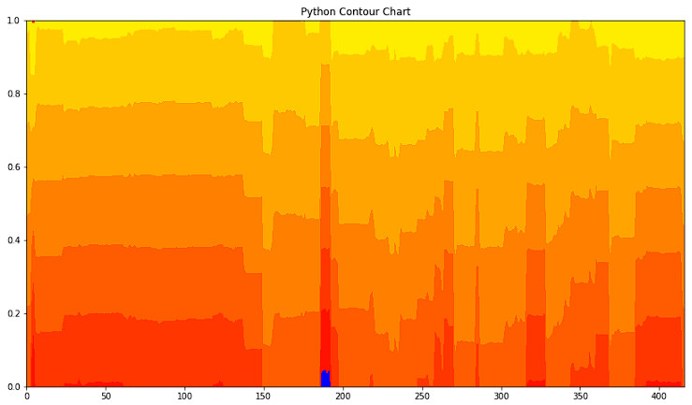
Python Charts

Slide 5
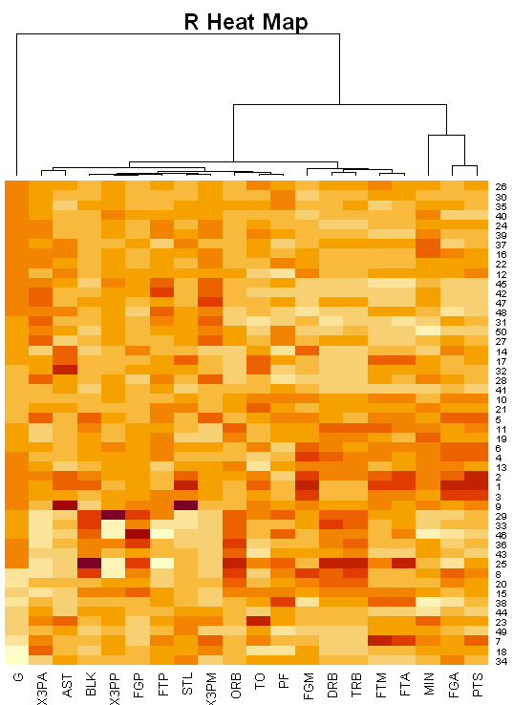
R Charts

Slide 6
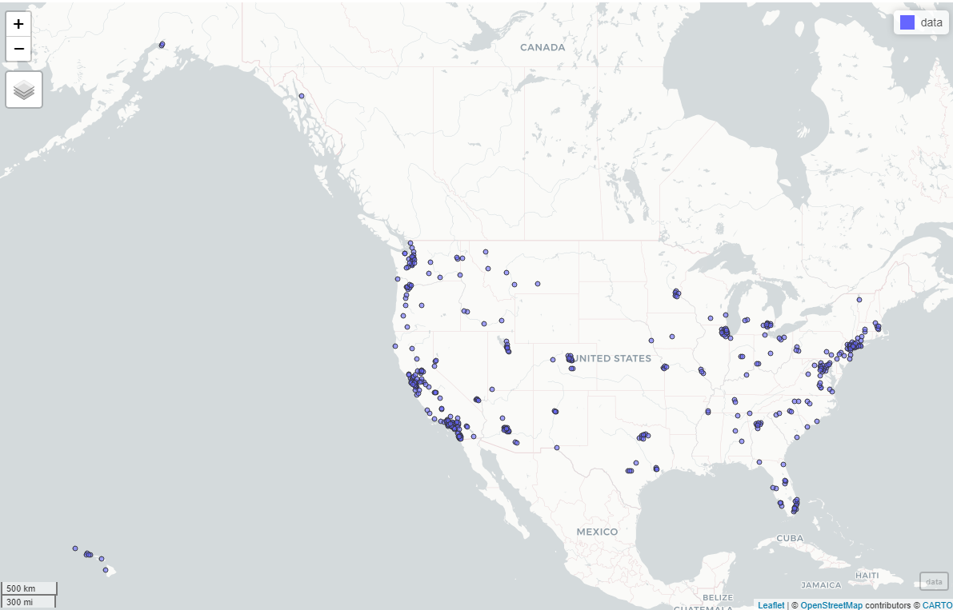
R Spatial Charts

Slide 7
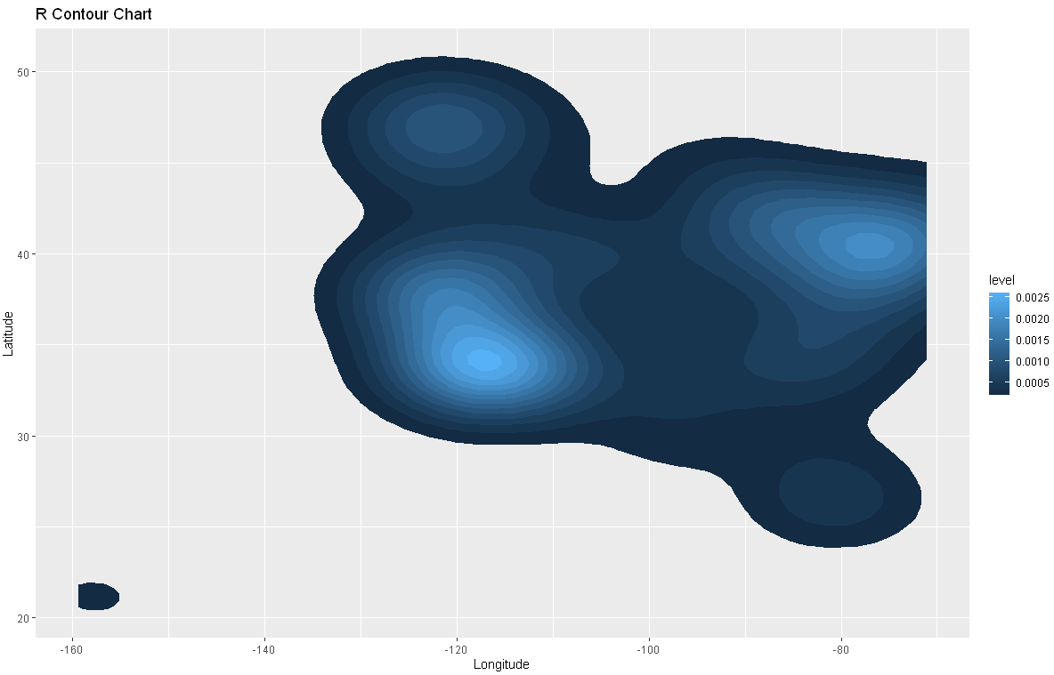
R Charts

Slide 8
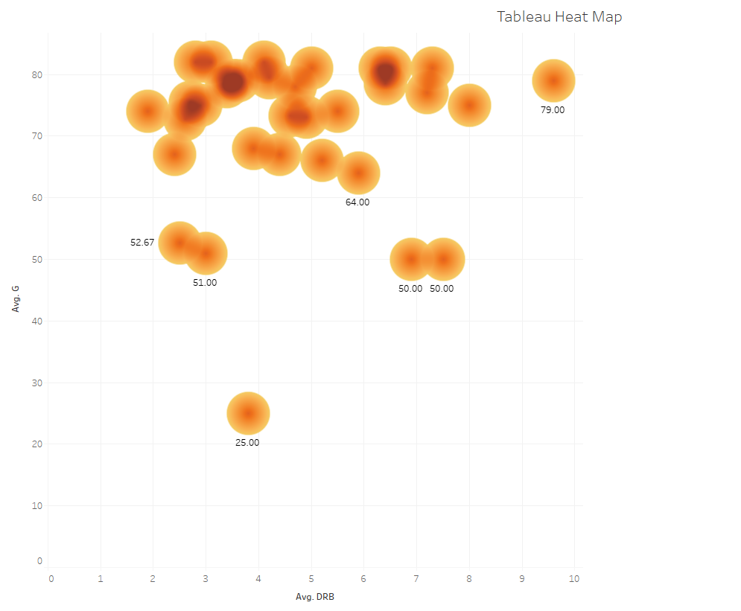
Tableau Charts

Slide 9
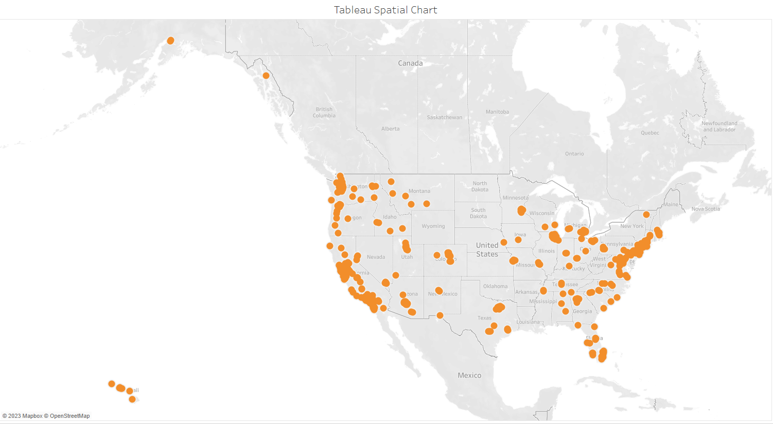
Tableau Charts

Slide 10
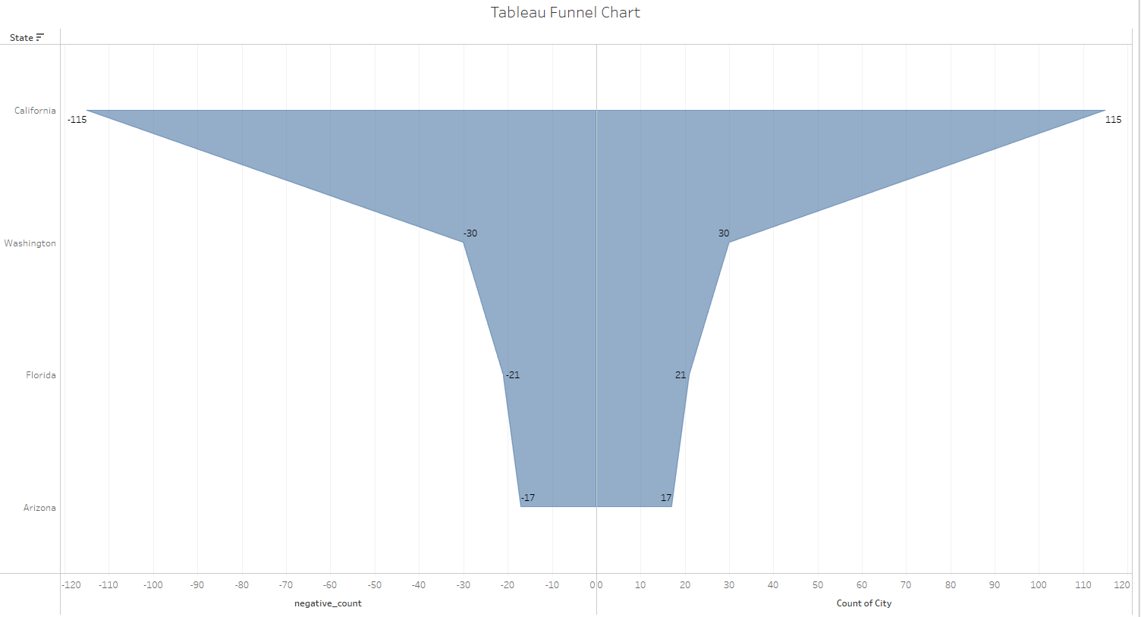
Tableau Charts

